Slide 1
SQL Server 2019 Bringing Apache Spark to SQL Server
James Herring
Big Data and AI Architect
FSUS TSP

Slide 2
In 2016
In 2025
16.1 ZBs of data was generated
163 ZBs of data will be generated
*IDC White Paper, Data Age 2025: The Evolution of Data to Life-Critical
Notes:
Increasing amount of data,

Slide 3
Organizations that transform data into insights outperform the competition
The task of generating insights from ever-increasing data is tough
Barriers to insights are barriers to success
Nearly double
operating margin
$100M in additional
operating income

Slide 4
Organizations that transform data into insights outperform the competition
What do these organizations do differently?
Integrate data without ETL
Combine data in a central data store
Perform predictive analytics
37% of leaders dynamically update data models
Leaders combine structured and unstructured data in a data lake 8X as often
74% of leaders use predictive models
Source: Keystone Strategy interviews Oct 2015 - Mar 2016
Notes:
The convergence of cloud, data, and AI leads to insights that transform.

Slide 5
SQL Server enables intelligence over all your data
Integrating all data
Managing all data
Analyzing all data
Unified access to all your data with unparalleled performance
Easily and securely manage
data big and small
Build intelligent apps and AI with all your data
Simplified management and analysis through a unified deployment, governance, and tooling

Slide 6
Integrating all data
Notes:
Challenge: Data movement can be problematic
Pillar: Gain unified access to all your data using data virtualization

Slide 7
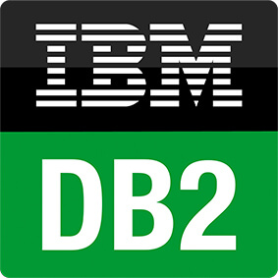








SQL Server is the hub for integrating data
Easily combine across relational and non-relational data stores
Analytics
T-SQL
Apps
SQL Server
PolyBase external tables
ODBC
NoSQL
Relational databases
Big Data
Excel
Cosmos DB
Notes:
Query across relational and non-relational data stores including Oracle, Teradata, Mongo etc
Besides supporting Hadoop, now PolyBase will let you query over RDBMS, NoSQL and generic ODBC sources.

Slide 8
Increase performance for data virtualization
SQL Server
Scale-out data pools combine and cache data from many sources for fast querying
Scenario
A global car manufacturing company wants to join data from across multiple sources including HDFS, SQL Server, and Cosmos DB
Solution
Query data in relational and non-relational data stores with new PolyBase connectors
Create a scale-out data pool cache of combined data
Expose the datasets as a shared data source, without writing code to move and integrate data
Scale-out data pool
Shard 1
Shard 2
Shard n
Polybase
connectors
HDFS
Cosmos DB
SQL Server
Notes:
Increase performance for data virtualization using data pools in scale-out data pools
SCENARIO: Scale out SQL Server with Hadoop and Spark to unlock Big Data
Scenario: A car manufacturing company wants to join data from across multiple sources including Cloudera for sensor data, SQL Server that has customer data with PII (that they want to keep in SQL and mask), and Cosmos DB that has connected car data in Azure. Today the car manufacturer has a Cloudera cluster with 100 nodes on-prem and 1.5 Petabytes of data. They are running into issues with Hive performance for interactive queries.
Problem: To join this data now, they would have to move it into a single system, a huge undertaking.
Solution: Create a shared, scalable data lake based on HDFS. Expose these datasets as a shared semantic layer, so that it can be used to business analysts without moving the data.
In this scenario, you still have to refresh the data periodically (still lives in its home database – not in the data lake)

Slide 9
Managing all data
Notes:
Challenge: Managing relational and Big Data is complicated
Pillar: Simplify big data management with improved performance and security

Slide 10
Easily deploy and manage a SQL Server + Big Data cluster
Easily deploy and manage a Big Data cluster using Microsoft’s Kubernetes-based Big Data solution built-in to SQL Server
Hadoop Distributed File System (HDFS) storage, SQL Server relational engine, and Spark analytics are deployed as containers on Kubernetes in one easy-to manage package
Notes:
Kubernetes-based Big Data distribution is easy to deploy, upgrade and patch, and scales in seconds using compute pools
visually tie this container to the containers in the previous slide
zoom in to show you what's inside one of the containers

Slide 11
Simplified deployment with containers & Kubernetes
Spark
SQL Server
A container is a standardized unit of software that includes everything needed to run it
Kubernetes is a container hosting platform
Benefits of containers and Kubernetes:
Fast to deploy
Self-contained – no installation required
Upgrades are easy because - just upload a new image
Scalable, multi-tenant, designed for elasticity
Provides abstraction layer so you can run anywhere
Container
HDFS Data Node
Kubernetes pod
Notes:
Picture: Master node of Kubernetes. It looks like a server (use Kubernetes slide from v3 of customer deck)
Below are many nodes of the Kubernetes, being driven by the master.
Show persistent storage that the container mounts to as a rectangle under the K8s node – “Persistent storage”

Slide 12
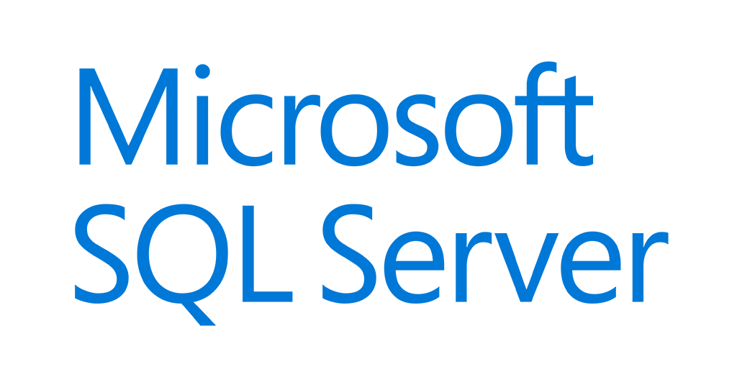




Increase analytics and apps performance
Custom apps
BI
Analytics
Cluster
SQL
SQL Server master instance
External data sources
Compute pool
Compute pool
Compute pool
Directly read from HDFS
SQL Compute Node
SQL Compute Node
SQL Compute Node
SQL Compute Node
…
SQL Compute Node
Data pool
Storage pool
SQL Data Node
SQL Data Node
Spark
SQL Server
Spark
SQL Server
…
Spark
SQL Server
HDFS Data Node
HDFS Data Node
HDFS Data Node
IoT data
Storage
Storage
Kubernetes pod
Node
Node
Node
Node
Node
Node
Node
Persistent storage
Notes:
Increase analytics and apps performance with scale out data pools

Slide 13
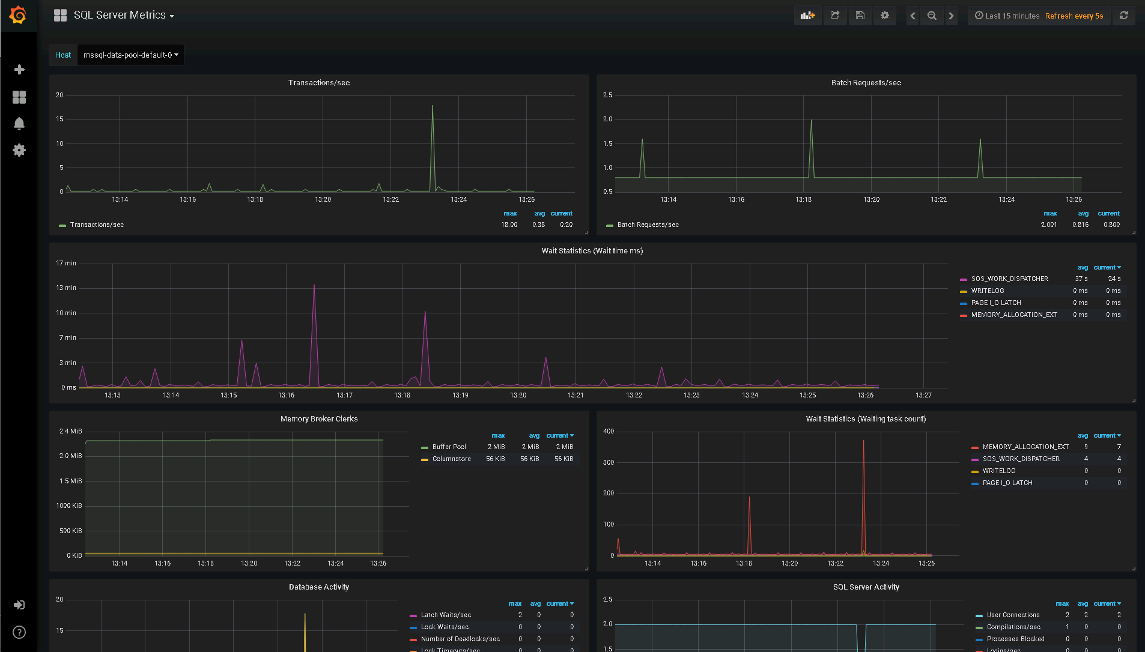
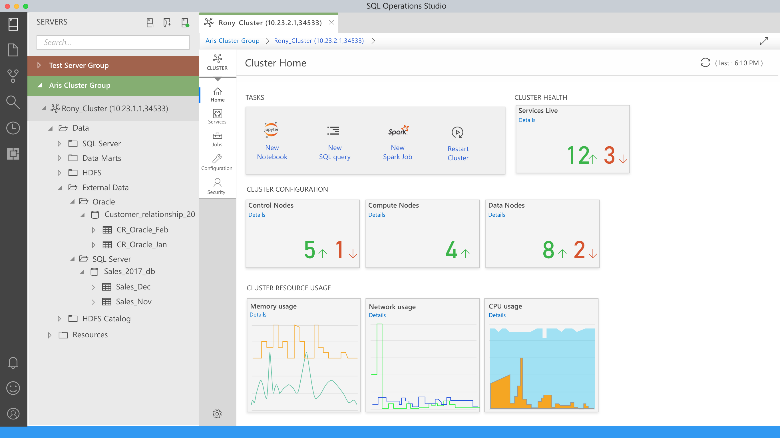
Unified development and administration
Azure Data Studio provides a unified tool for querying data using a notebook experience for both T-SQL and Spark
Easily access all your data across SQL Server and HDFS
The cluster administration portal provides easy to use cloud-style managed services for HA, monitoring, backup/recovery, security, and provisioning.
The REST API and command line tools simplify automation
The development and management experience is consistent regardless of where you run – on prem or any of the major cloud providers
Notes:
Unified development and administration experience for big data and SQL Server users

Slide 14
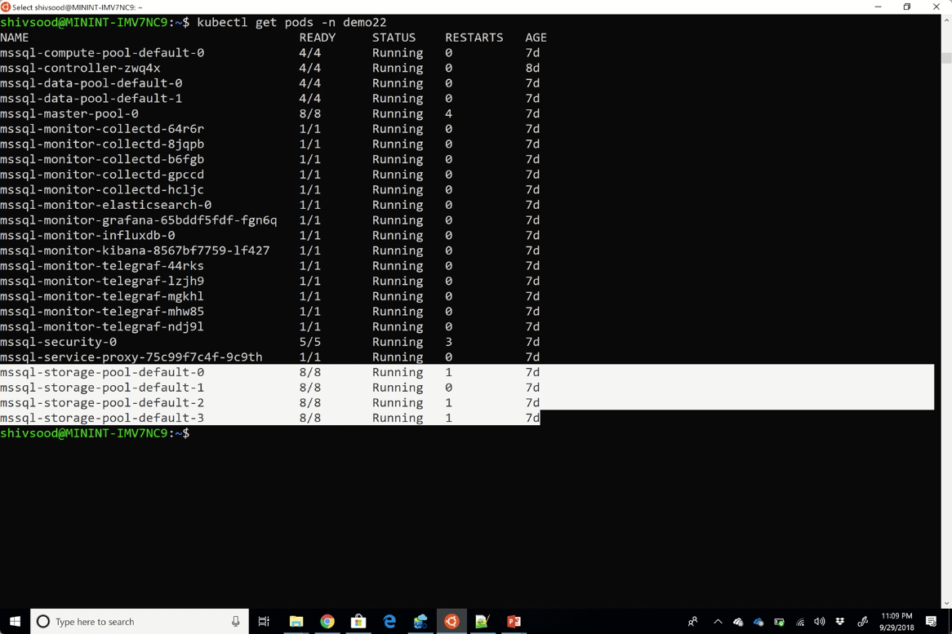

Slide 15
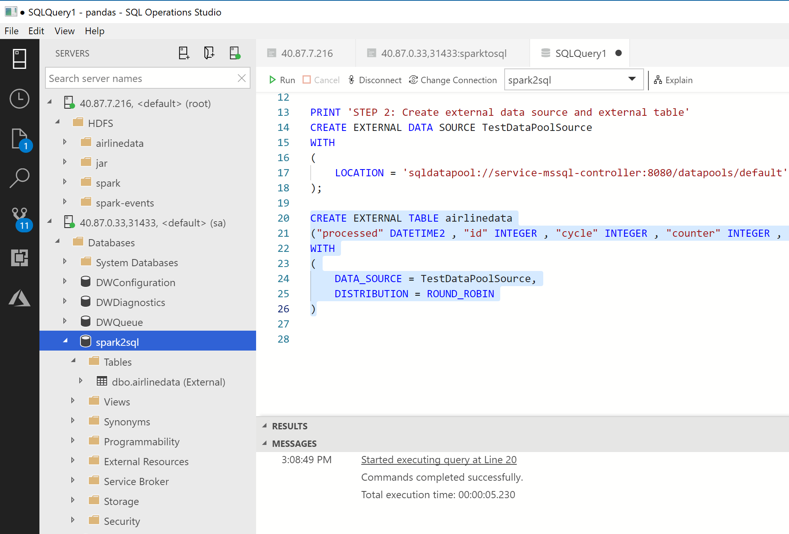
2. External Table created

Slide 16
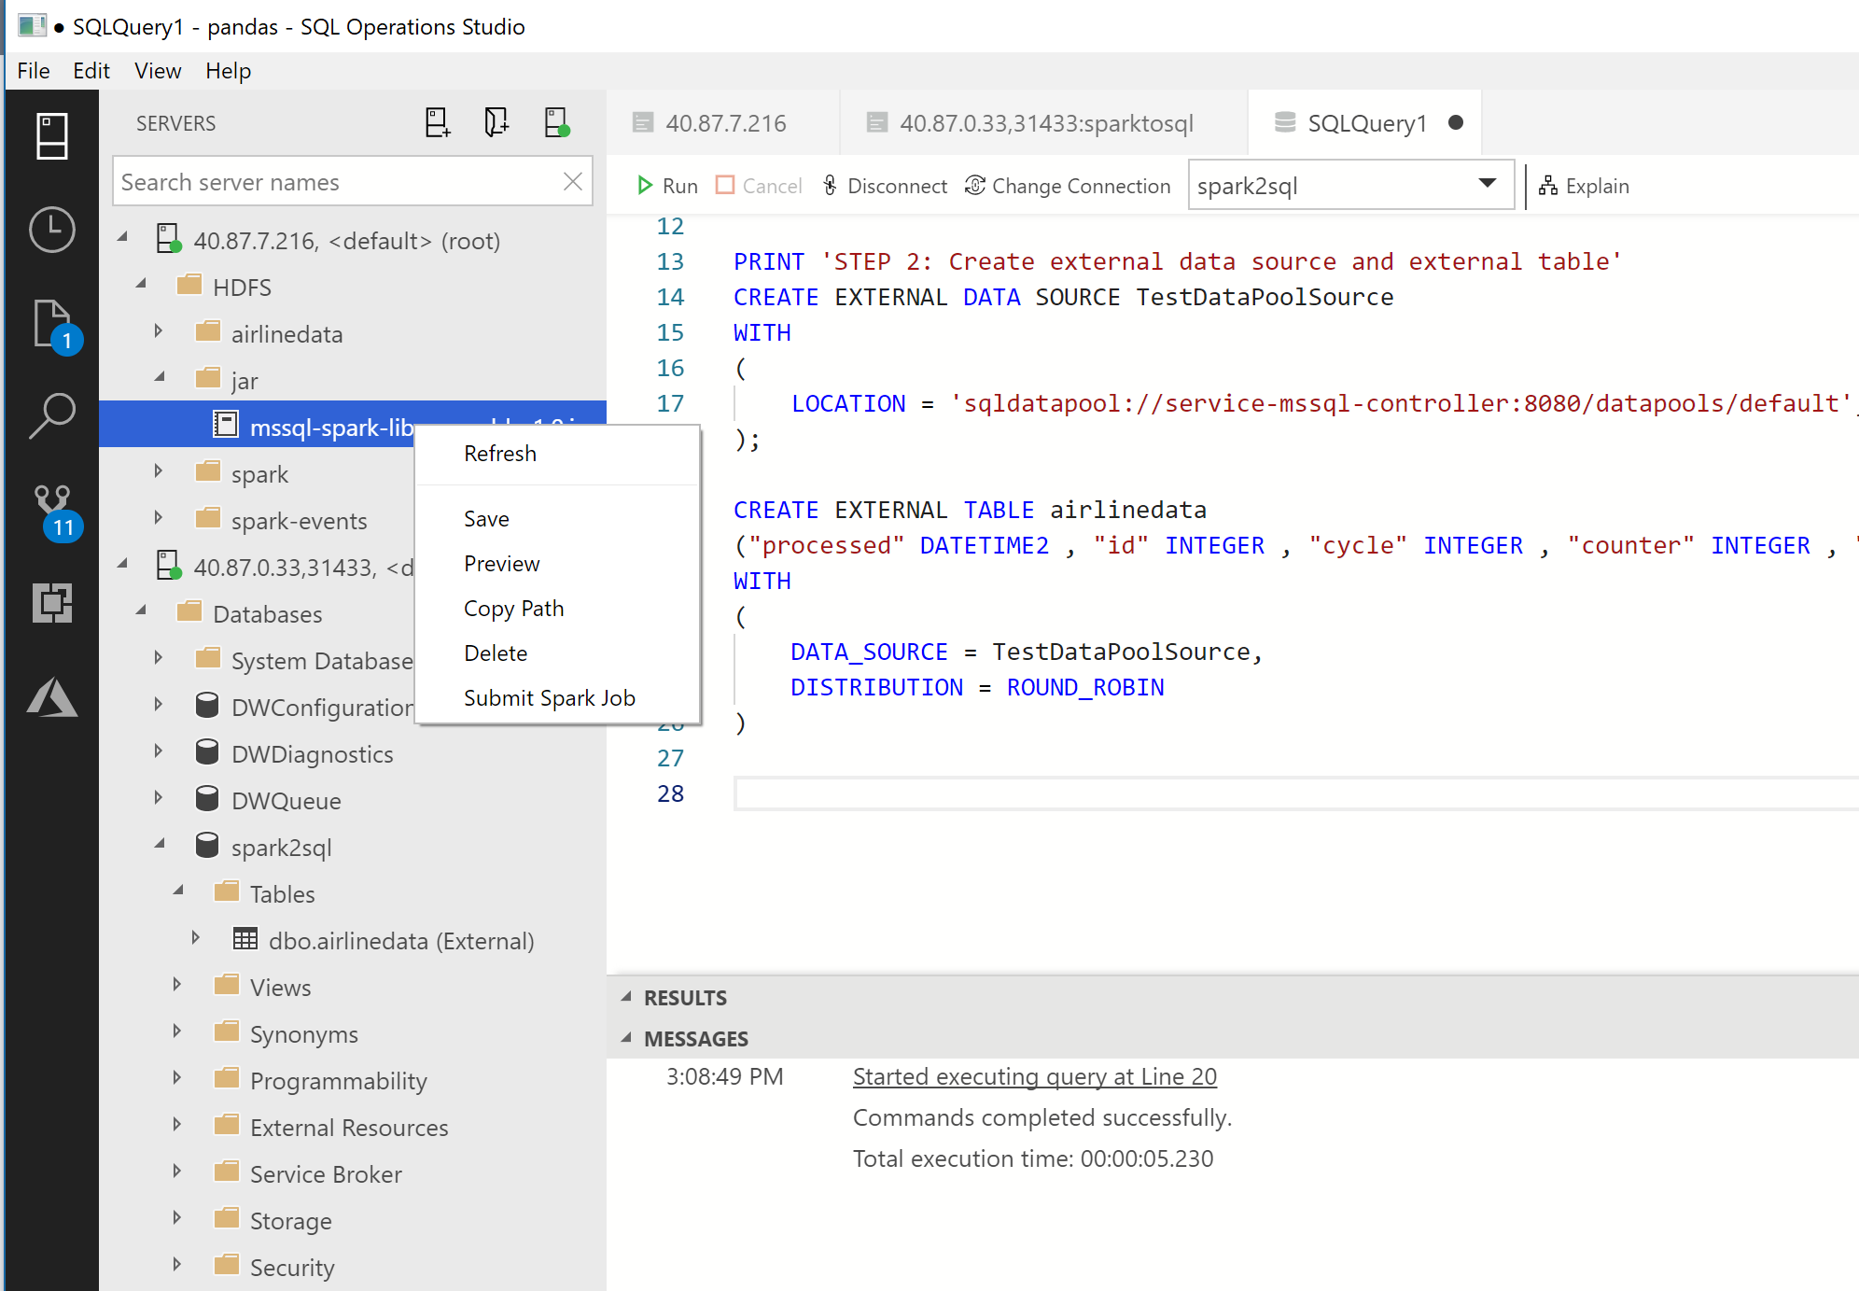
4. Copy the path of the Spark Jar file ( This can be a local file)

Slide 17
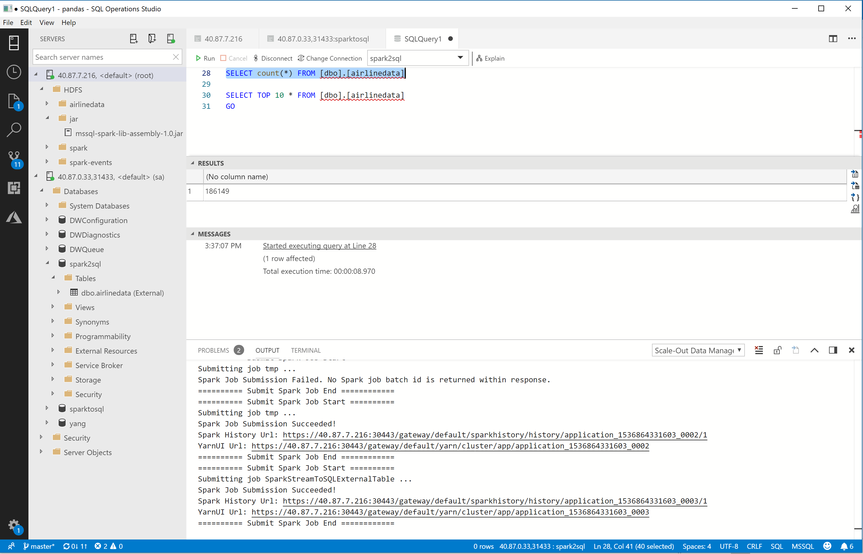

Slide 18
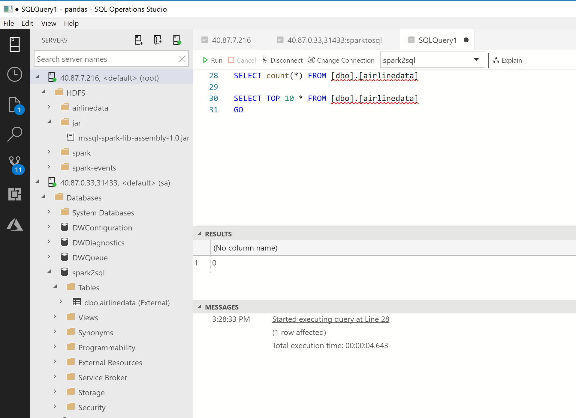

Slide 19
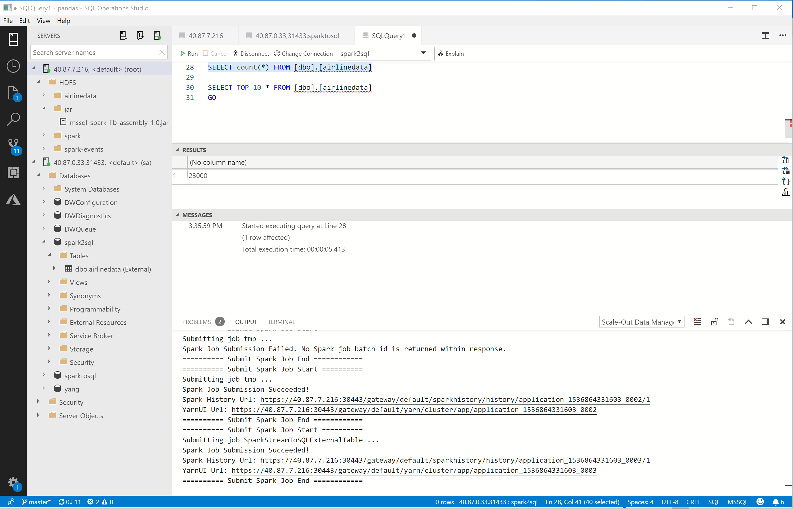

Slide 20
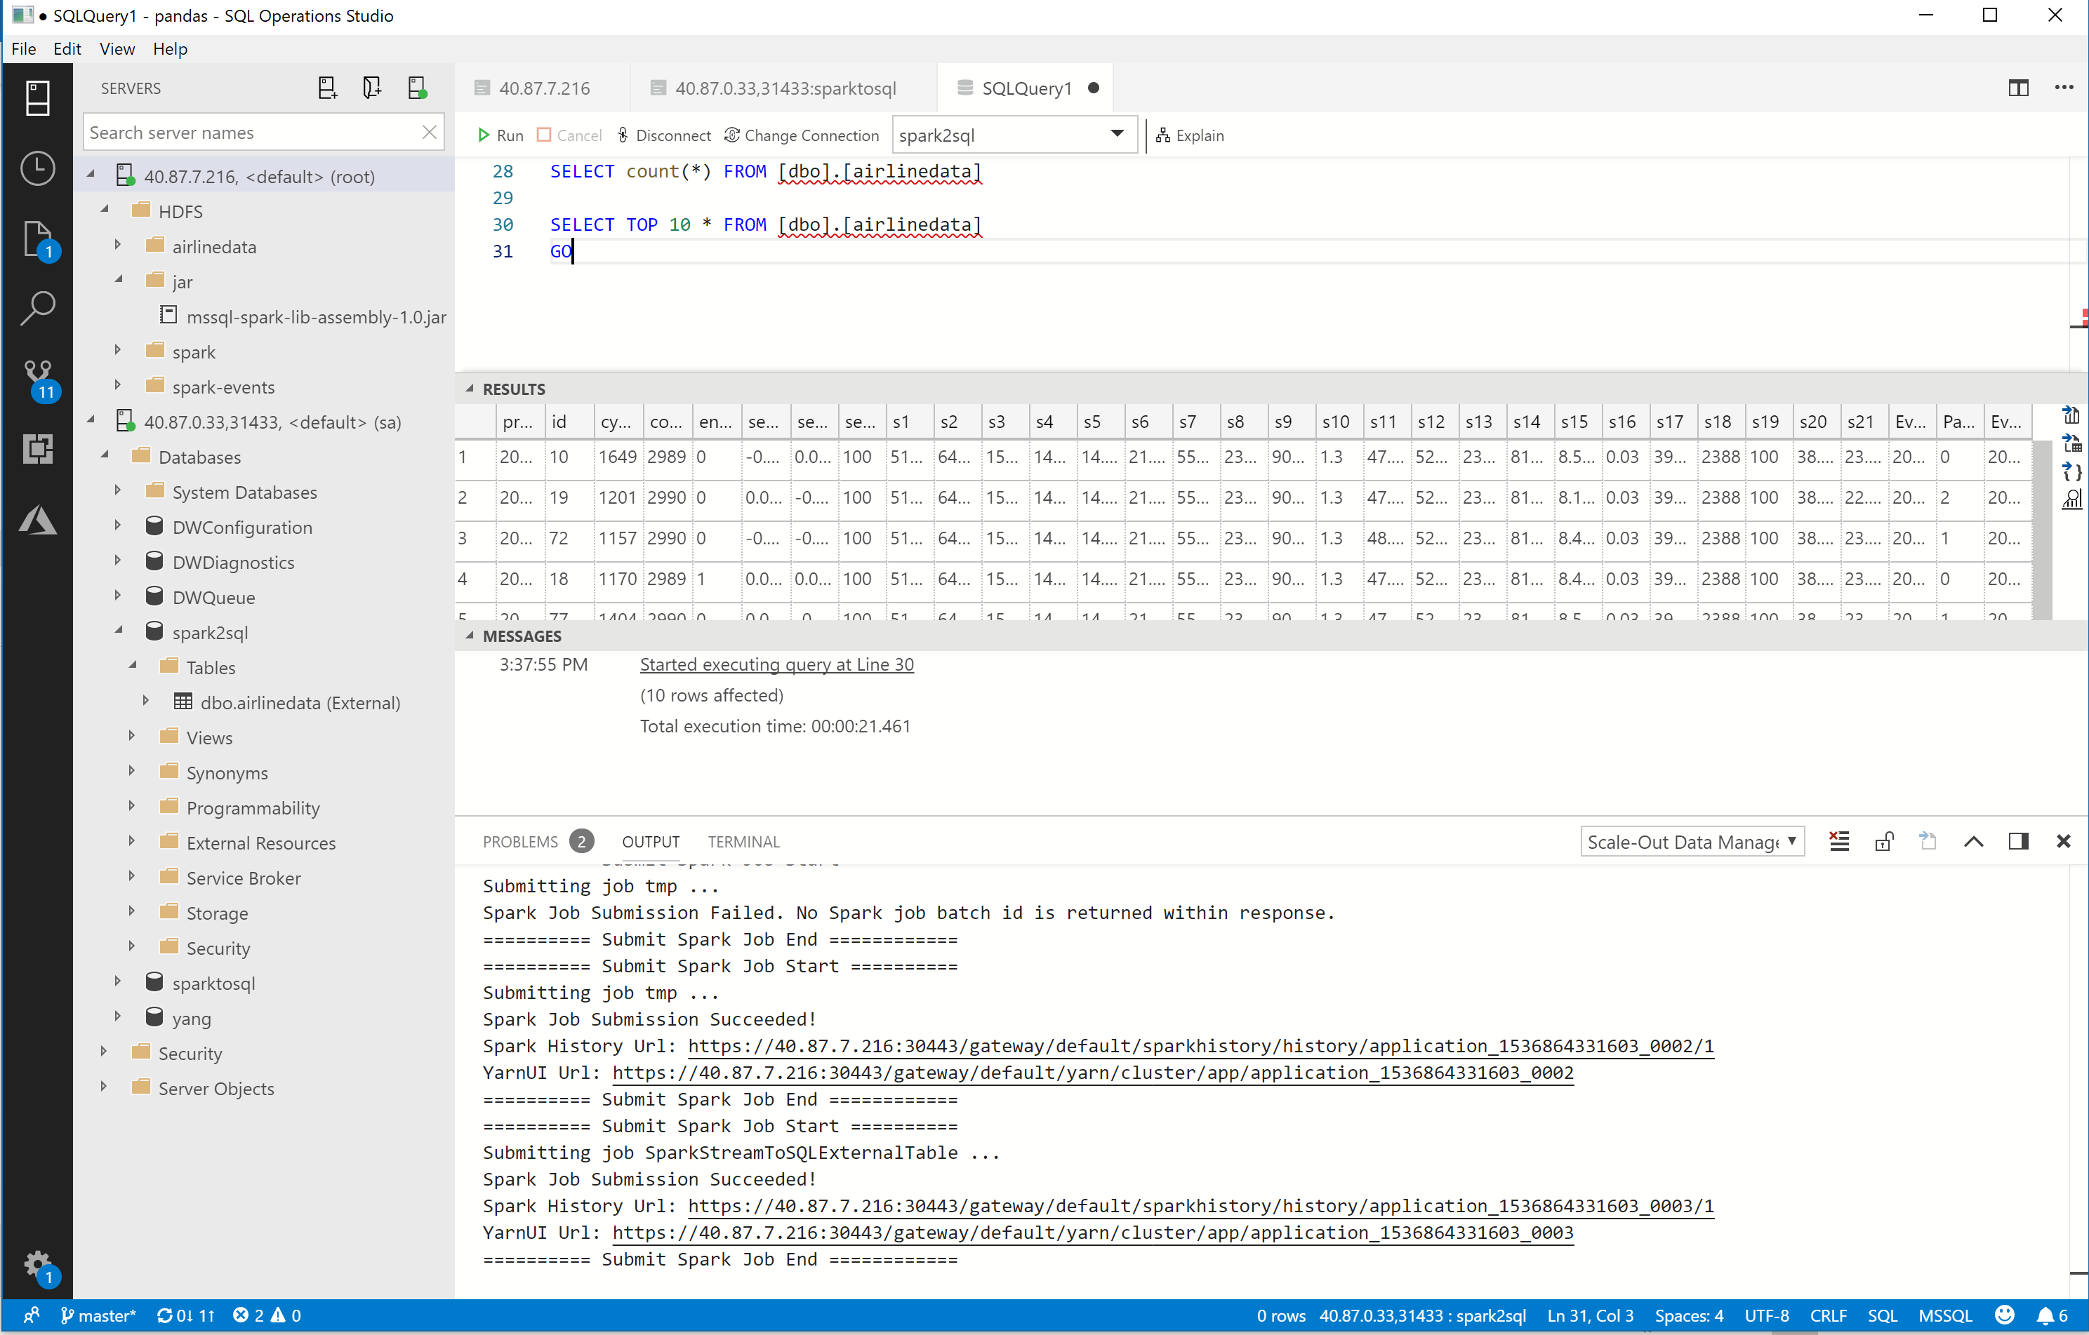

Slide 21
Analyzing all data
Notes:
Challenge: Managing relational and Big Data is complicated
Pillar: Simplify big data management with improved performance and security

Slide 22



Integrate structured and unstructured data
Ingest
Store
Prep & train
Model & serve
Logs, files and media
(unstructured)
SQL Server data pools
Spark
Predictive apps
Spark streaming
SQL Server master instance
Sensors and IoT
(unstructured)
HDFS
Spark ML
Business/custom apps
(Structured)
SQL Server master instance
SQL Server ML Services
REST API containers for models
BI tools
Simplified management and analysis through a unified deployment, governance, and tooling
Notes:
Easy tooling to ingest, store, prep & train, model and serve high velocity using unified data management
Spark streaming in the box
Data preparation tools
Integrated Jupyter notebooks

Slide 23
Intelligence over all data drives innovation
SQL Server 2019 big data & analytics
Data virtualization
Managed SQL Server, Spark, and data lake
Complete AI platform
Admin portal and management services
Integrated AD-based security
Analytics
T-SQL
Apps
REST API containers for models
SQL Server External Tables
SQL Server
Spark
SQL Server
ML Services
Spark & Spark ML
Compute pools and data pools
Scalable, shared storage (HDFS)
Open database connectivity
NoSQL
Relational databases
HDFS
External data sources
HDFS
Combine data from many sources without moving or replicating it
Scale out compute and caching to boost performance
Store high volume data in a data lake and access it easily using either SQL or Spark
Management services, admin portal, and integrated security make it all easy to manage
Easily feed integrated data from many sources to your model training
Ingest and prep data and then train, store, and operationalize your models all in one system
Integrating all data
Managing all data
Analyzing all data

Slide 24
Apply to join the SQL Server Early Adoption Program
https://aka.ms/eapsignup
Notes:
Get started today with the SQL Server v.Next preview by going to https://aka.ms/eapsignup

